Slide 1
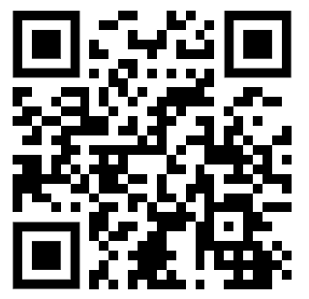
Software Engineering
WS-2018-2019
22. Oct
29. Oct
From 15.00-18.30 h Room 8-103
05.Nov
12.Nov
19.Nov
26.Nov
03.Dec
10.Dec
17.Dec
14.Jan
21.Jan
28.Jan
26.Jan
04.Feb
11.Jan
https://www.linkedin.com/groups/8689804/

Slide 2
Who is me?
Damir Dobric
Microsoft PTSP (Partner Technical Solution Specialist) Microsoft Most Valuable Professional Microsoft Regional Director
damir.dobric@daenet.com
https://about.me/damirdobric

Slide 3
What will we do?
.NET Core 2.1
github
C#
Machine Learning

Slide 4
No exam!
You will deliver a real project!
Start: Nov.2018
Project Presentation: approx. End of Feb. 2018

Slide 5
Good to know
You learn about applied Software Engineering
We will combine theory with applicable solutions.
We learn and work as professional developers.
All you learn is applicable in industry right now
We will not learn anything old.
If you want to learn cool things you will enjoy this course
There is no specific book. But there is enough learning material in internet.

Slide 6
Prerequisites
You need to know one programming language at least. We do not learn any programming language in this course! If you don’t know any programming language it will be more difficult.
Project will be done in C# / .NET Core We will help you to learn C#.
Every group has a machine with Windows 10 as VM and Visual Studio 2017 Community Edition. This is all you need to do all required practices.
Code samples and project do not require much coding. You will learn enough of C# in course to be able to implement project if you know at least one programming language.
All presentations and related documents can be found on github.

Slide 7
How do we work?
We use Linked-In network. https://www.linkedin.com/
Your Group Name on Linked-In: UNI-2018-2019
We will use the group for communication.
Chat
Announcements
Anything else
We will cover theoretical part as PowerPoint with live discussion.
Everything will be uploaded after/during lesion (PPTX, Samples, Paintings).
Your can also upload anything you think it is important for all.
Use internet resources. For example videos.
Use this platform for communication with other colleagues.

Slide 8
Registration in Excel
Please enter your name and email address here.
https://bit.ly/2AnOgRp

Slide 9
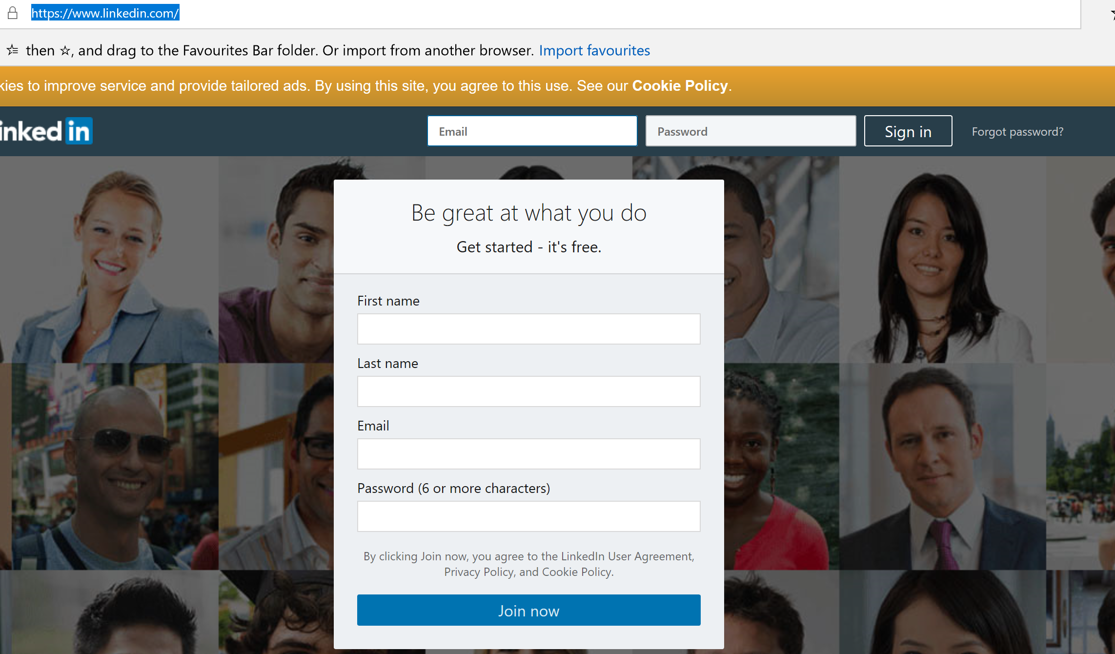
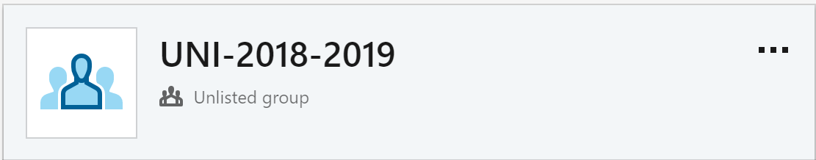
Register on Linked-In
https://www.linkedin.com/

Slide 10
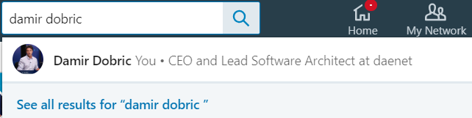
Invite us
Damir Dobric
Patrick Renner

Slide 11
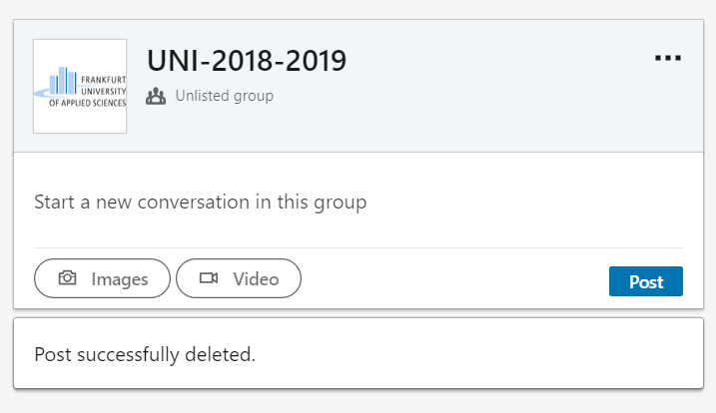
We will send you invite for group

Slide 12
How to reach me?
I do not have an office at university. I’ll be mostly at 14.45h Mondays in the meeting room.
You can reach me almost every day/night including weekend!
Use my Linked-In contact for urgent and private questions. Don’t contact me directly for general questions, which all other might be interested on.
For all other project and course related questions use linked-in timeline or github issues.
You can follow me on twitter: https://twitter.com/ddobric
You can follow me on my blog: http://developers.de/

Slide 13
How the project is scored?
Regularly and continuous learning through sprints (2 iterations per month)
Your knowledge about .NET Core / C#
Your solution must compile, run and fulfill the task.
If you run in unsolvable issues, you will not fail.
If you want best score (<2.0) you will work on github.

Slide 14
ALM
Application Life Cycle Management
(Scoping Software Projects)

Slide 15
Application lifecycle management (ALM), called also ADLM (Application Development Life-cycle Management)

Slide 16
ALM encompasses
Requirements management
Software architecture
Implementation
Testing
Maintenance
Change management
Continuous integration
Project management
Release management

Slide 17
ALM Frameworks
CMMI
Capability Maturity Model Integration
Started in 1987 as the Capability Maturity Model (CMM), at the Software Engineering Institute
MSF
Microsoft Solution Framework
Set of principles, models, disciplines, concepts, and guidelines for delivering information technology solutions from Microsoft
SCRUM

Slide 18
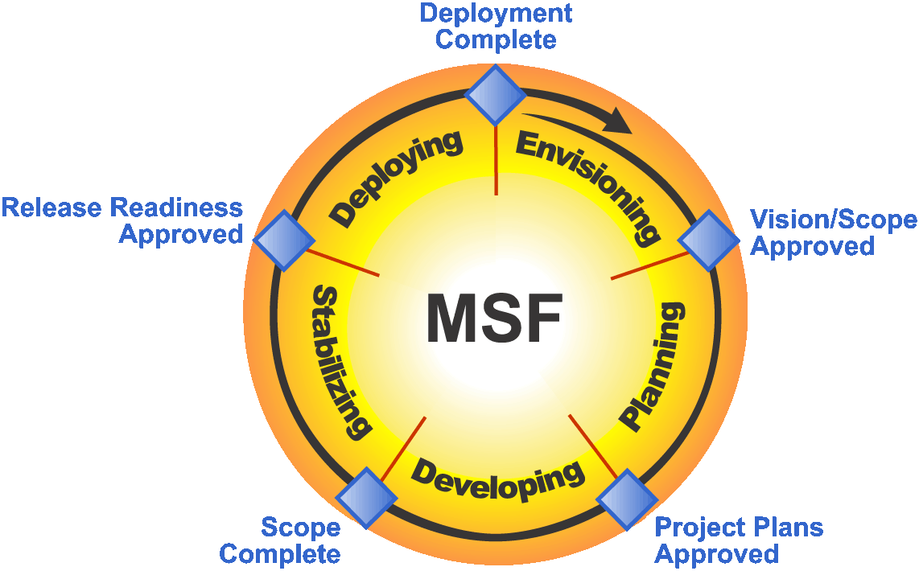
MSF-Agile

Slide 19
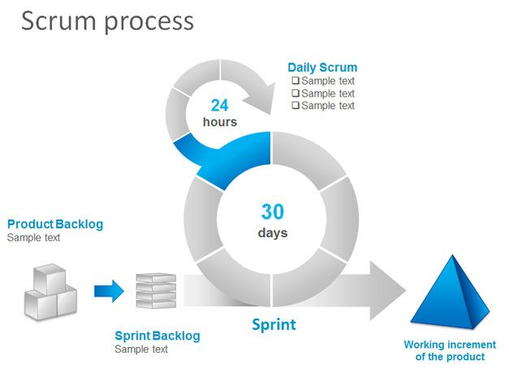
Scrum
“Scrum is a framework for developing and sustaining complex products”.

Slide 21
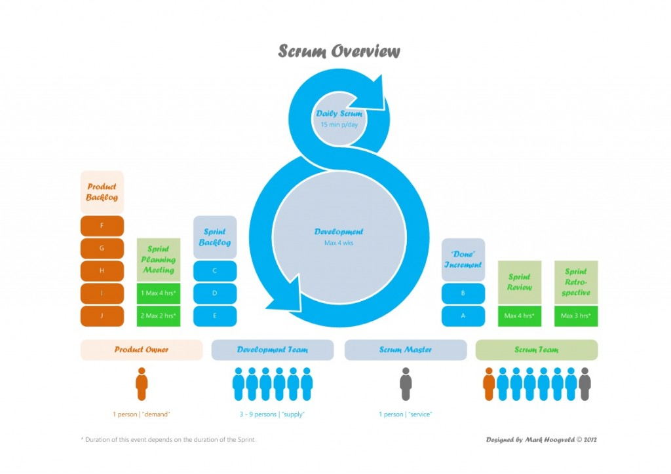

Slide 22
SCRUM Model
Epic ->(Vision)
Feature -> (has date but no effort)
- Backlog Item 1 (has an effort+fits in the sprint)
- Backlog Item 2
…
- Backlog Item N ->
Task N1
Task N2
…
Task MN

Slide 23
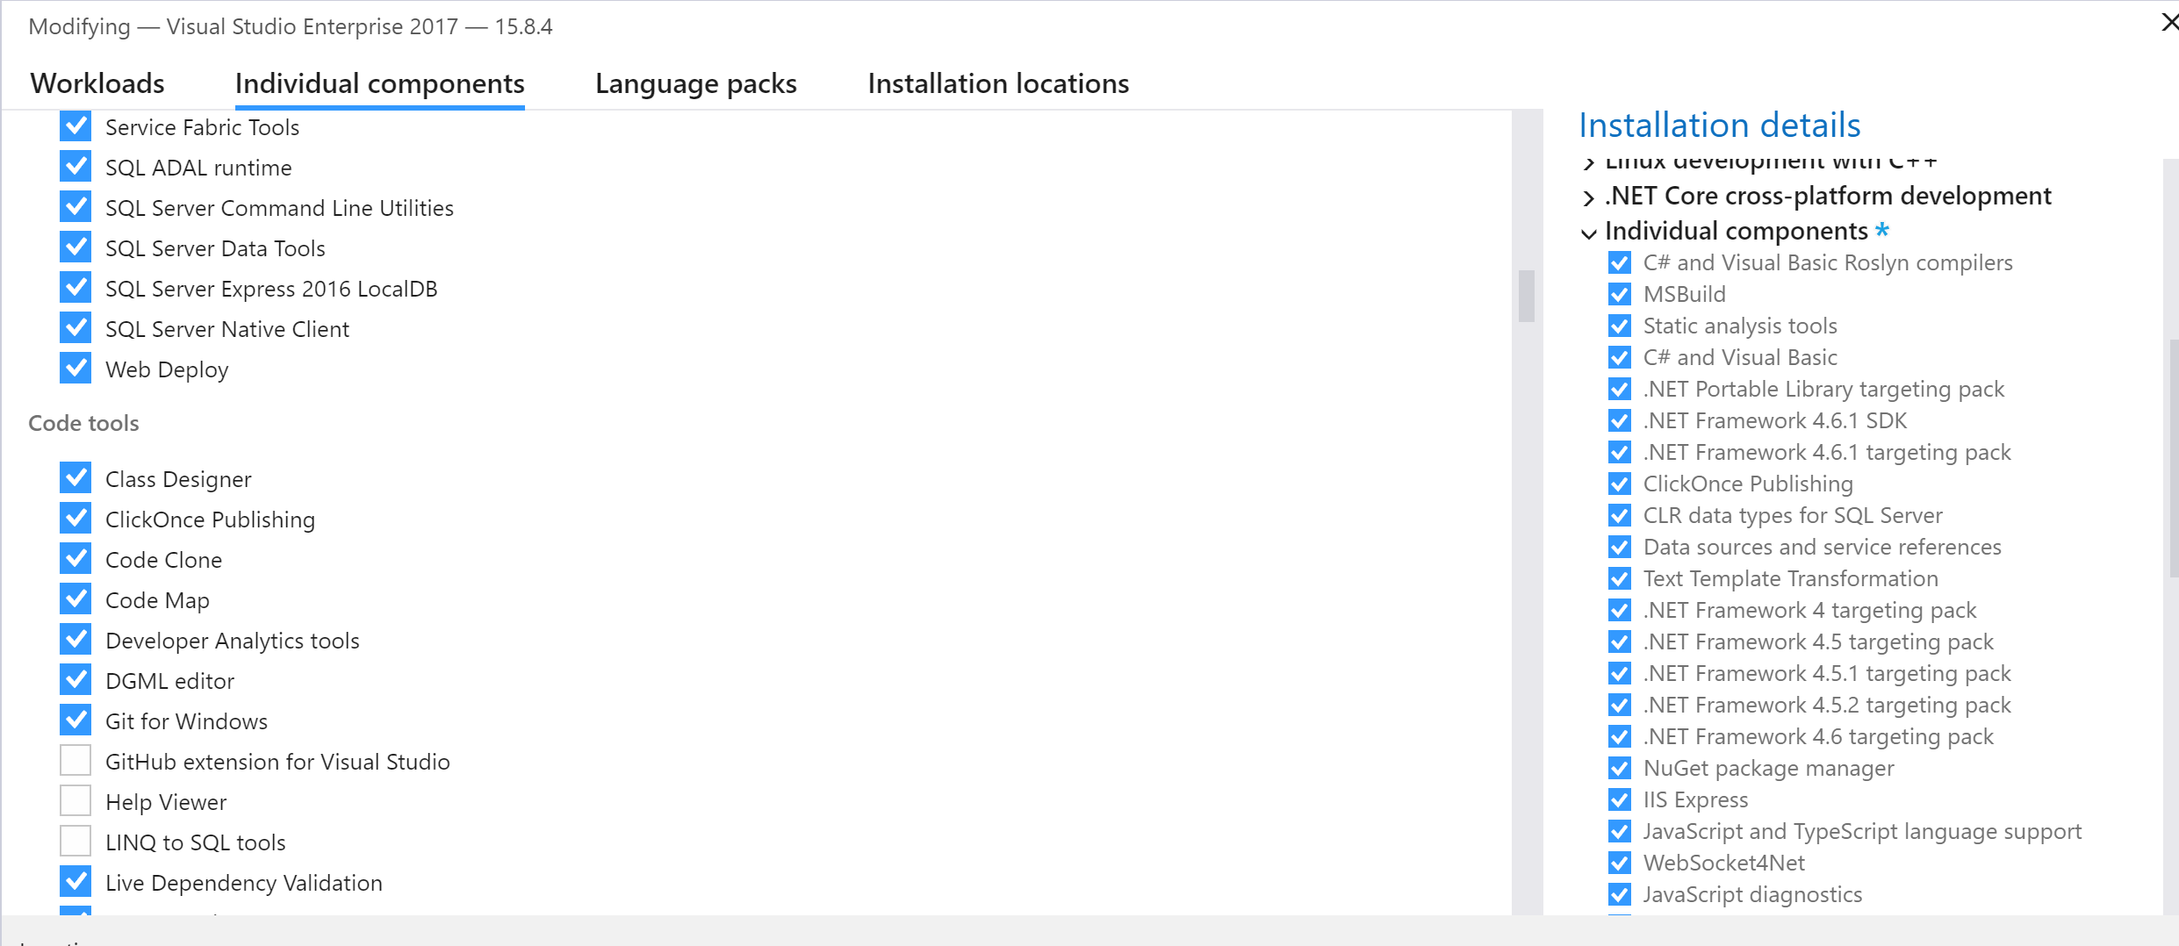
Tools you need
Visual Studio 2017 Community Edition
https://visualstudio.microsoft.com/downloads/
Select GIT

Slide 24
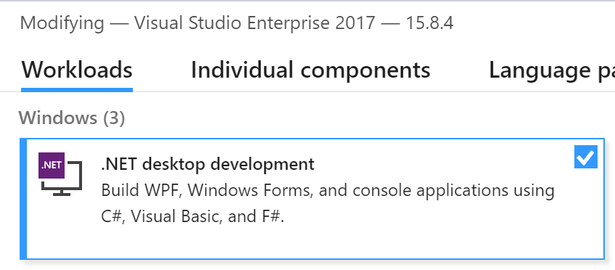
Tools you need

Slide 25
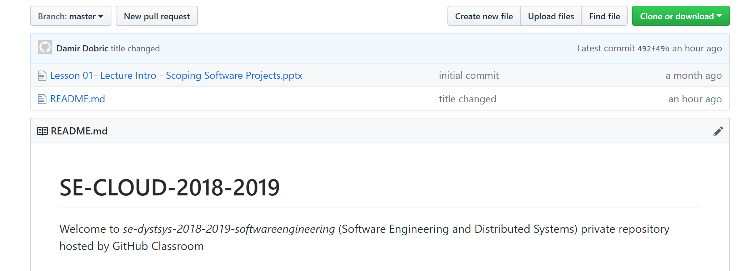
Git Classroom
Our GitHub Organization (PUBLIC):
https://github.com/UniversityOfAppliedSciencesFrankfurt
Our Classroom (PRIVATE):
https://github.com/UniversityOfAppliedSciencesFrankfurt/se-dystsys-2018-2019-softwareengineering

Slide 26
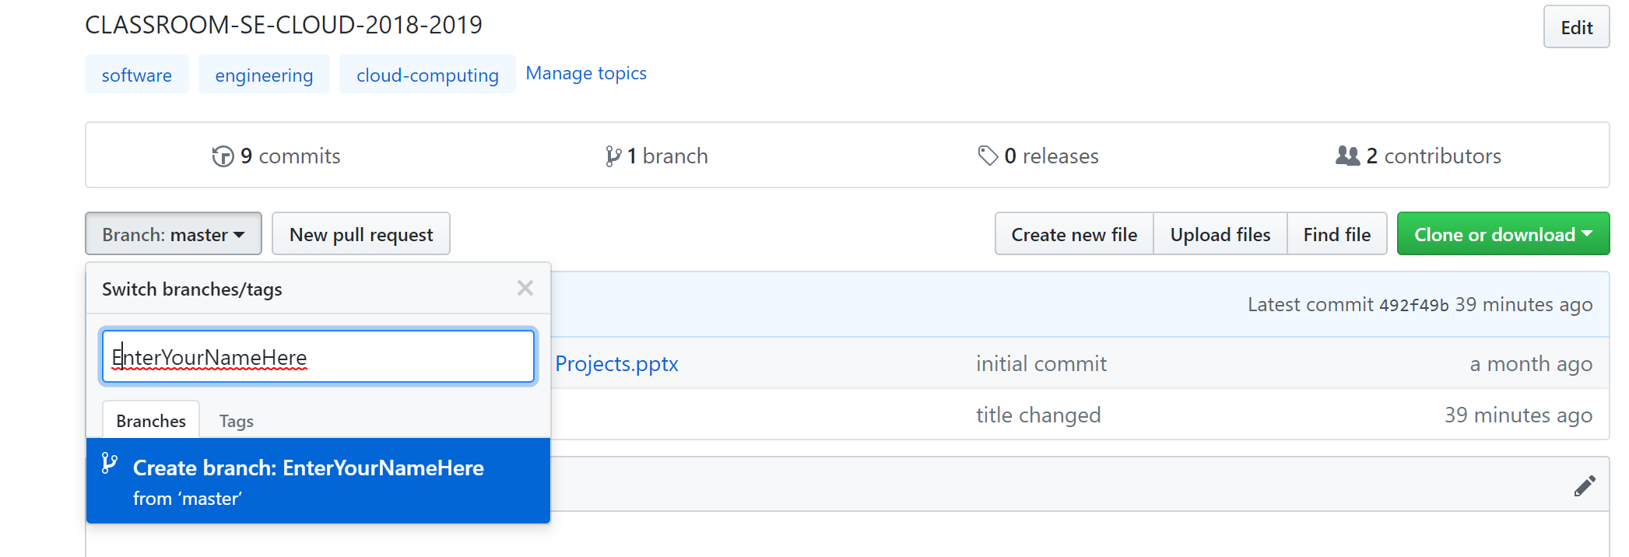
Your tasks for first sprint
Sprint starts NOW.
Sprints ends in two weeks. 1. Install VS 2. Create your branch on git. 3. Try to play with GIT (use VS or CLI)
Create some files
Commit files
Change files
4. Create Console Application

Slide 27
Let’s start
Enter your name in attendee list
Register on Linked-In
Connect to Damir & Patrick
Register on GitHub
Install Visual Studio on your own laptop
OR update Visual Studio on Workstation in front of you.

Slide 28
Learning C#
https://www.microsoft.com/net/tutorials/csharp/getting-started

